Slide 1
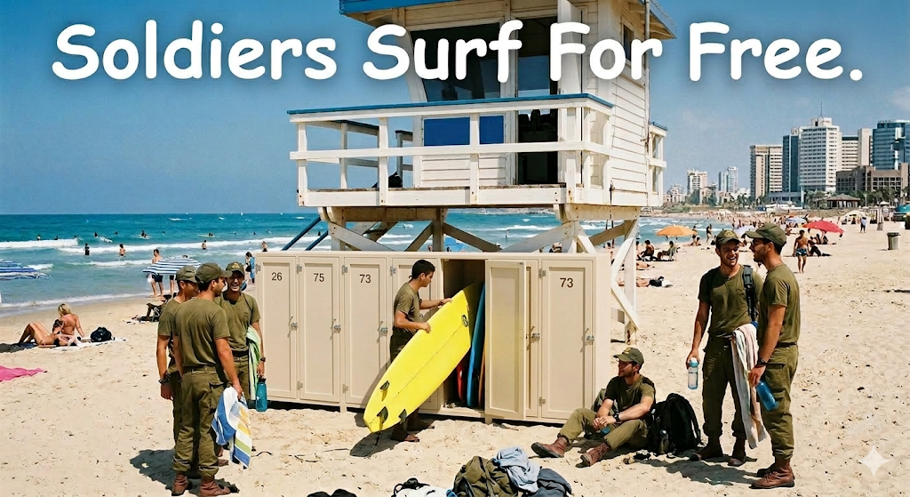
Soldiers Surf Free
Segev Olpak, Ofek Yabo, Dolev David, Guy Yehoshua

Slide 2
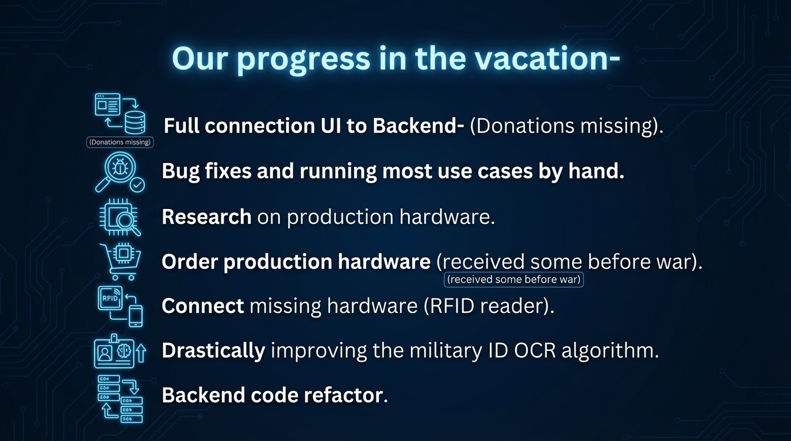

Slide 3
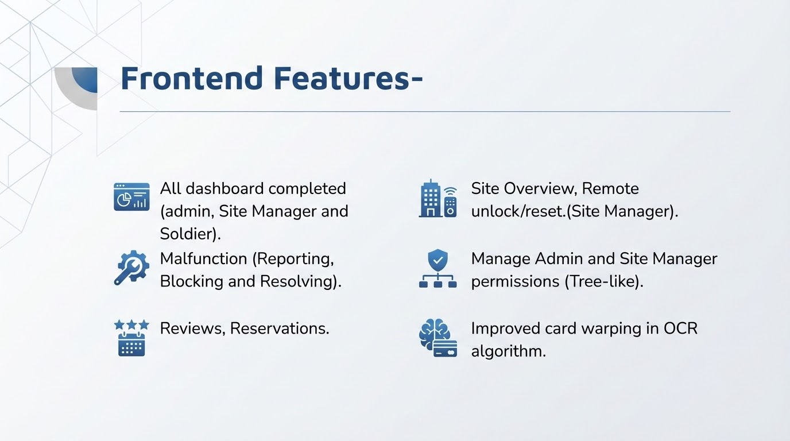

Slide 4
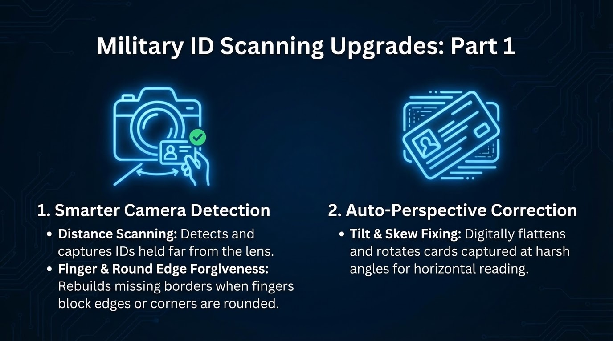

Slide 5
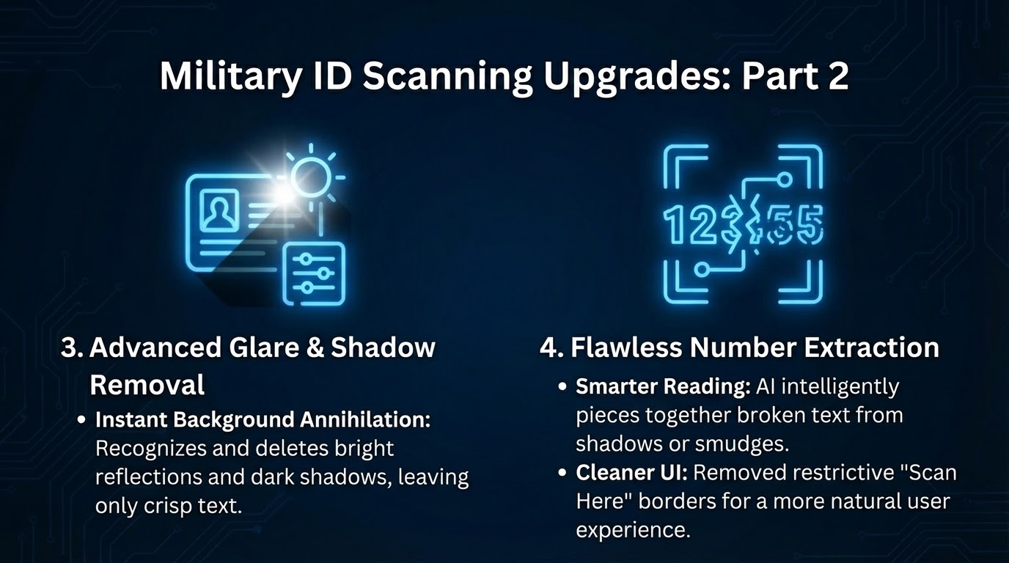

Slide 6
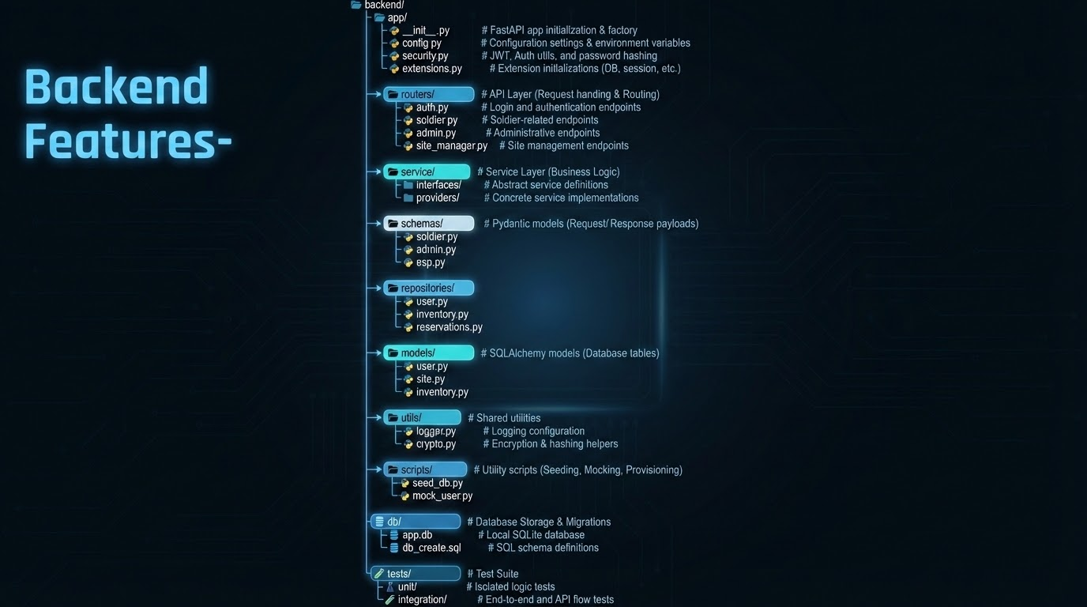

Slide 7

Physical Features-

Slide 8
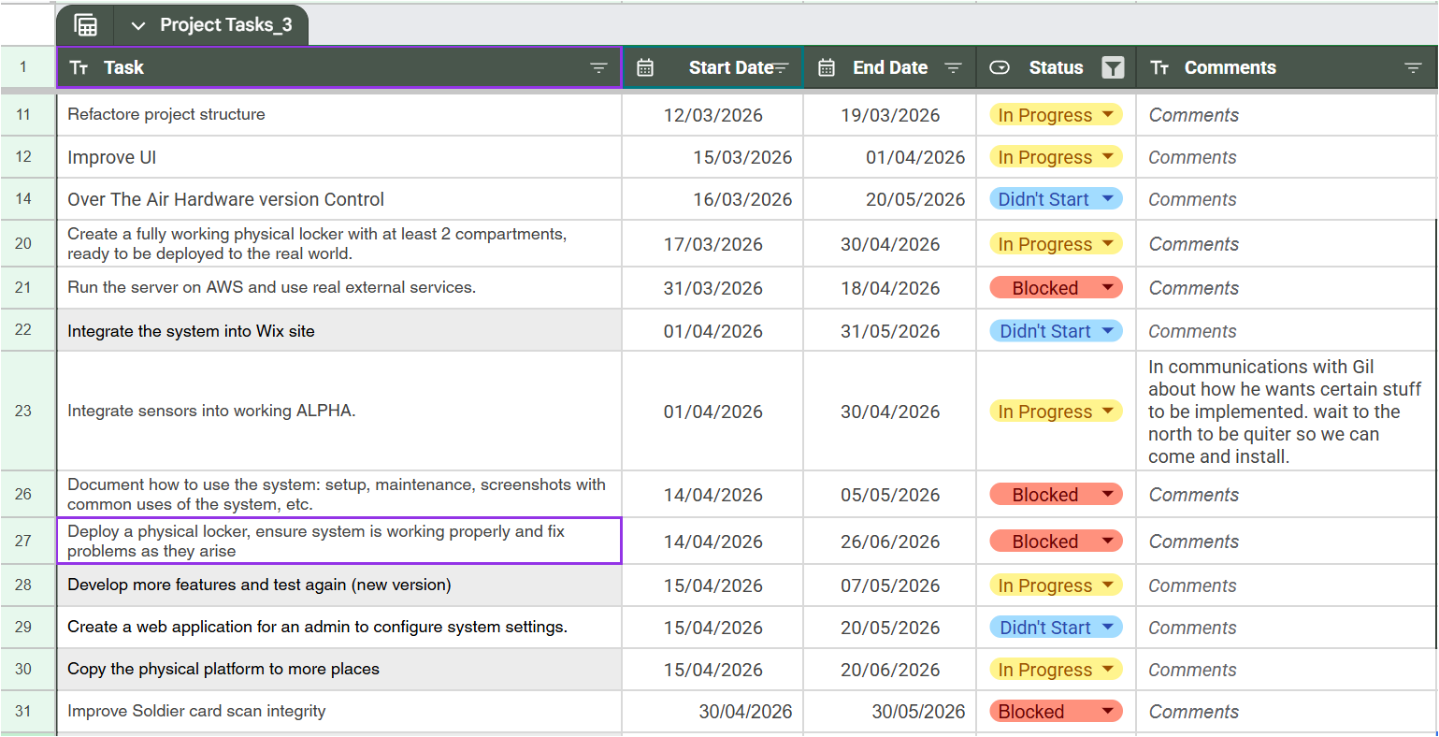
Gantt-

Slide 9
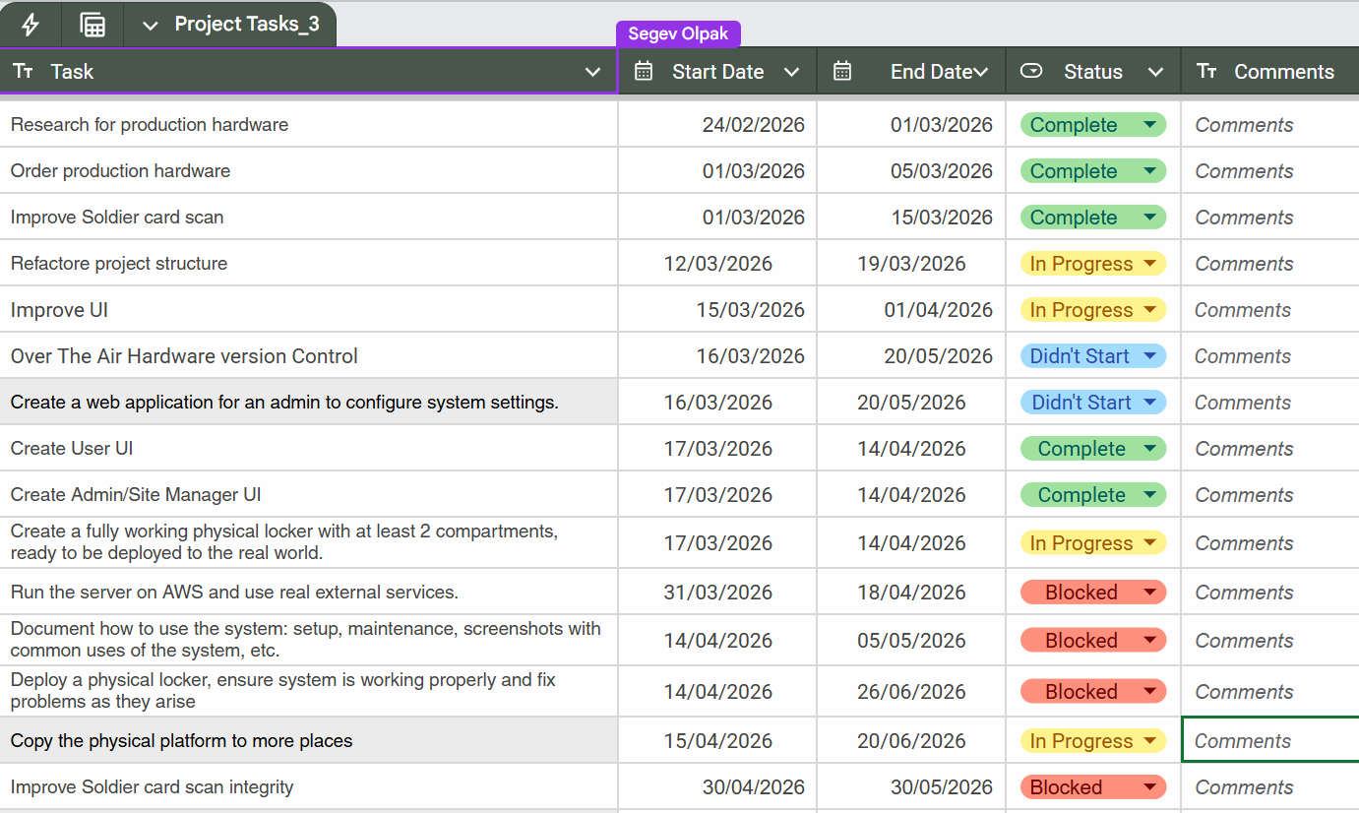
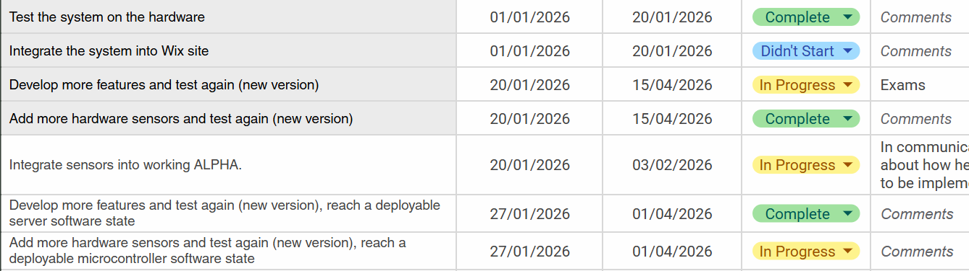
Gantt-

Slide 10
Our progress in the vacation-
Full connection UI to Backend- (Donations missing).
Bug fixes and running most use cases by hand.
Research on production hardware.
Order production hardware (received some before war).
Connect missing hardware (RFID reader).
Drastically improving the military ID OCR algorithm
Backend code refactor

Slide 11
Frontend Features-
All dashboard completed (admin, Site Manager and Soldier).
Malfunction (Reporting, Blocking and Resolving).
Reviews, Reservations.
Site Overview, Remote unlock/reset.(Site Manager).
Manage Admin and Site Manager permissions (Tree-like).
Improved card warping in OCR algorithm.

